Slide 1
Screen Control Using Gestures
SRM INSTITUTE OF SCIENCE AND TECHNOLOGY
SCHOOL OF COMPUTING
DEPARTMENT OF COMPUTING TECHNOLOGIES
21CSE292P Artificial Intelligence of Things
Guide name : Dr. TYJ Naga Malleswari
Designation : Associate Professor (NWC) Department : Computing Technologies
Team Members
Student 1 Reg. No: RA2211003011296
Student 1 Name : Aman Goel
Student 2 Reg. No: RA2211003011344
Student 2 Name : Ayushi Mishra

Slide 2
Agenda
Abstract
Introduction
Motivation
Literature Review
Findings of the survey /Challenges & Limitations of the existing system
Objectives
Proposed Architecture
Methodology /Algorithms
Module Description
Experimental Set up
Results
References

Slide 3
Abstract
Our project aims to develop an innovative Gesture Control System that allows users to interact with computer screens using just hand gestures. The system accurately tracks hand movements and translates them into mouse and keyboard actions.
A custom trained neural network with a custom dataset ensures high accuracy in gesture recognition, enhancing the overall detection speed and the user experience and interaction.

Slide 4
Introduction
Gesture control technology has seen significant advancements in recent years which has opened up new possibilities for users to interact with digital devices. Traditional input methods such as mouse and keyboard sometimes limit in terms of use and accessibility.
Our project seeks to address these limitations by developing a gesture-based control system that enables users to perform various actions on their computer screens using just our fingers and hand movements.

Slide 5
Motivation
Gesture-based control systems can make technology more accessible to people with physical disabilities or limited mobility, enabling them to interact with computers and other devices more easily.
Exploring gesture-based control is a way to push the boundaries of human-computer interaction, leading to new and more intuitive ways of interacting with technology.

Slide 6
Literature Survey
S.No | Title | Author Name, Year of Publication and Journal Name | Methodology | Metrics | Drawbacks
1 | Hand Gesture Recognition Based on Computer Vision: A Review of Techniques | José María Armingol and Arturo de la Escalera, 2020 and Journal of Imaging | Include skin color, appearance, motion, skeleton, depth, 3D model, and deep learning detection | Include accuracy, precision, recall, and the F1 score | Include challenges in complex backgrounds, illumination variations, and occlusions
2 | Real-time hand gesture recognition for human-computer interaction | Antonio J. Colmenarez and Thomas S. Huang, 2001 and Image and Vision Computing | Using computer vision techniques including skin color and motion analysis. | Include accuracy, precision, recall, and F1 score | Include challenges in handling varied lighting conditions, complex backgrounds, and occlusions
3 | Bringing Gesture Recognition to All Devices | Bryce Kellogg, Vamsi Talla, and Shyamnath Gollakota, 2014 and NSDI '14 | Include low-power analog operations to extract the amplitude of wireless signals | Include classification accuracy, response time, and false positive rate | Include limited range due to lower transmission frequencies and reduced accuracy in through-the-pocket scenarios
4 | Gesture Recognition Based Mouse Events | Rachit Puri, early 2010s and Samsung Research India-Bangalore | Include capturing hand gestures using a webcam, converting RGB values to the YCbCr color model | Include recognition rate and response rate | nclude the need for color caps on fingers and potential variations in recognition accuracy due to different skin tones and textures
7/29/2022

Slide 7
Literature Survey
S.No | Title | Author Name, Year of Publication and Journal Name | Methodology | Metrics | Drawbacks
5 | A Real-time Hand Gesture Recognition and Human-Computer Interaction System | Pei Xu, 2017 and arXiv repository. | Include hand detection, gesture recognition using CNN, and an interaction scheme with humans to avoid false recognition | Include high accuracy and effective interaction performance | Include single monocular camera for hand detection and background removal making it challeging to separate the hand region from the background in cluttered or unpredictable environments
6 | A New Virtual Keyboard with Finger Gesture Recognition for AR/VR Devices | Tae-Ho Lee and Hyuk-Jae Lee, 2018 and Lecture Notes in Computer Science series | Include defining a new type-in action for virtual keyboards in AR/VR devices, where the contact between the thumb and index finger signifies a keystroke | Include the speed of typing (characters per minute) and the error rate | Reliance on a single camera, which may limit accuracy and robustness in different lighting conditions or with complex backgrounds
7 | Finger Recognition and Gesture-based Virtual Keyboard | Chinnam Datta Sai Nikhil Chukka, Uma Someswara Rao, E.Brumancia, K.Indira, T.Anandhi, and P.Ajitha , 2020 and ICCES | Involves background subtraction for hand region segmentation | Include the accuracy and contolling cursor using different hand gesture | Reliance on sufficient lighting conditions, limiting its usability in outdoor environments or poorly lit rooms
7/29/2022

Slide 8
Literature Survey
S.No | Title | Author Name, Year of Publication and Journal Name | Methodology | Metrics | Drawbacks
8 | The Word-Gesture Keyboard: Reimagining Keyboard Interaction | Shumin Zhai and Per Ola Kristensson, 2012 and Communications of the ACM | Include the development and testing of the word-gesture keyboard concept andhuman performance modeling | Include user performance measures such as speed (words per minute), error rate | Include the learning curve for users to transition from visually guided tracing to memory-driven gesturing, and the challenge of optimizing the keyboard layout for efficiency
9 | Handwritten Gesture Recognition for Gesture Keyboard | R. Balaji, V. Deepu, Sriganesh Madhvanath, and Jayasree Prabhakaran , 2006 and Tenth International Workshop on Frontiers in Handwriting Recognition | Involves a data-driven approach for recognizing basic shapes of gestures | Include top-choice accuracy for individual g-strokes and entire syllables, with a target accuracy | Potential for reduced accuracy due to variations in writing styles, pen tilt, and hardware limitations
10 | Bimanual Gesture Keyboard | Xiaojun Bi, Ciprian Chelba, Tom Ouyang, Kurt Partridge, and Shumin Zhai, 2014 and UIST conference | Methods for gesture keyboard: finger release and space required | Include input speed, corrected error rate and gesture length | slightly slower than unimanual gestures, likely due to the attention and action switches required between fingers
7/29/2022

Slide 9
Findings of the survey /Challenges & Limitations of the existing system
Optimization Needs: Difficulty in optimizing keyboard layouts for efficiency and the challenge of optimizing interaction schemes to prevent false recognitions.
User Interface and Interaction Issues: Potential for action switches required between fingers and issues with the user interface that can interrupt the workflow.
Error Rates: Error rates in gesture recognition need to be minimized for practical usability.
Speed and Efficiency: Some methods are slower than traditional typing, possibly due to the cognitive load involved in gesture recognition.

Slide 10
Objectives
Gesture-based controls can make interactions more fluid and engaging, particularly for touchless or hands-free scenarios.
Gestures can provide an alternative input method for users with mobility impairments or those who find traditional input devices challenging to use.
Gestures can be faster and more efficient than using a mouse or keyboard, especially for specific tasks like navigating large datasets or complex interfaces.
Gesture-based interactions can enhance user engagement and make applications more appealing to a wider audience.

Slide 11
Proposed System Architecture
Novelty:
The latest paper which is made is using python 3.8.0 with autopy and since this version is old and contains bugs so we used pyautogui instead of autopy as it doesn’t work after 3.9.0. WE ARE USING PYTHON 3.10.11 which is far efficient and optimized than pre-existing systems
We have used a custom dataset for the detection model with over 4000+ photos of ourselves making the detection more accurate and combined it with pyautogui to give it a simulation for keyboard
Till now no one has combined and ai virtual mouse with keyboard functionality having the accuracy of neural network making the accuracy detection very high ranging from 99.75% to 100% in some training cases

Slide 12
Methodology /Algorithms
Step 1: Start
Step 2: Initialize camera settings, frame reduction, smoothening factor, FPS, and command counters.
Step 3: Use the HandTrackingModule.py to detect a hand in the camera frame.
Step 4: For gesture recognition use mediapipe to check:
Check if the index finger is raised for moving the mouse.
Check if the index and middle fingers are raised for left-clicking.
Check if the thumb and index finger are raised for right-clicking.
Check if the pinky finger is raised for scrolling up/down.
Check if specific fingers are raised for minimizing the window.
Step 5: Use the OpenCV to calculate the distance between fingers and to perform some functions like:
Move the mouse position based on the movement of the index finger.
Perform left-click or right-click based on finger positions.
Scroll up or down based on the pinky finger position.
Minimize the window based on the finger positions.

Slide 13
Methodology /Algorithms
Step 6: Create a custom dataset for keyboard gesture and preprocess the data.
Step 7: Train the model to detect the sign that represents an alphabet and use PyAutoGUI to execute the action.
Step 8: For display and control of model we implement:
Display the camera feed with annotations for hand and finger positions.
Update the FPS counter and display it on the screen.
Control the loop to break when specific gesture is detected.
Step 9: For visualization use matplotlib and imshow() function from openCV.
Step 10: End

Slide 14
Modules
For creating virtual mouse, we use:
- cv2 (OpenCV): Used for capturing video from the webcam, displaying the video feed, drawing on the video frames, and various image processing task.
-NumPy: Used for numerical operations, particularly for manipulating arrays which represent image data.
-HandTrackingModule (htm): A custom module (presumably created by the user) that handles hand detection and tracking using computer vision techniques.
-time: Used for measuring time intervals, which is useful for calculating the frame rate (FPS) and timing certain actions like clicks.
-pyautogui: Used for simulating mouse movements and clicks based on the hand tracking data.
-matplotlib.pyplot: Used for plotting and visualizing data, such as the duration of commands executed during the program's runtime.
For creating a custom module which track hand, we use:
-Modules like cv2(OpenCV), numpy and time use for same function that we use in virtual mouse.
-mediapipe: A library developed by Google for building multimodal applied machine learning pipelines. It is used for hand tracking and detecting landmarks on the hand.
-math: Provides access to mathematical functions, used here for calculating the Euclidean distance between points.

Slide 15
Modules
For collecting images, we use:
- cv2 (OpenCV): Used for capturing video from the webcam, displaying the video feed, drawing on the video frames, and various image processing task.
-os: Provides functions for interacting with the operating system, such as creating directories.
For creating a dataset, we use:
-Modules like cv2(OpenCV), os, mediapipe and matplolib.pyplot use for same function that we use in collecting images and module for hand tracking.
-pickle: For serializing and deserializing Python object structures to and from a file.
For detection of alphabets, we use:
-Modules like cv2(OpenCV), mediapipe and numpy use for same function that we use in collecting images and module for hand tracking.
-pickle: Used to load a pre-trained machine learning model from a file.

Slide 16
Modules
For training model, we use:
-pickle: For loading and saving data and the trained model to and from files.
-sklearn.ensemble: Specifically, RandomForestClassifier for building a random forest classifier for hand gesture classification.
-sklearn.model_selection: Specifically, train_test_split for splitting the dataset into training and testing sets.
-sklearn.metrics: Specifically, accuracy_score for evaluating the performance of the model by calculating the accuracy of the predictions.

Slide 17
Experimental Set up
Python 3.10.11
tensorflow 2.13.0
opencv-python 4.9.0.80
scikit-learn 1.3.2
Mediapipe 0.9.0.1

Slide 18
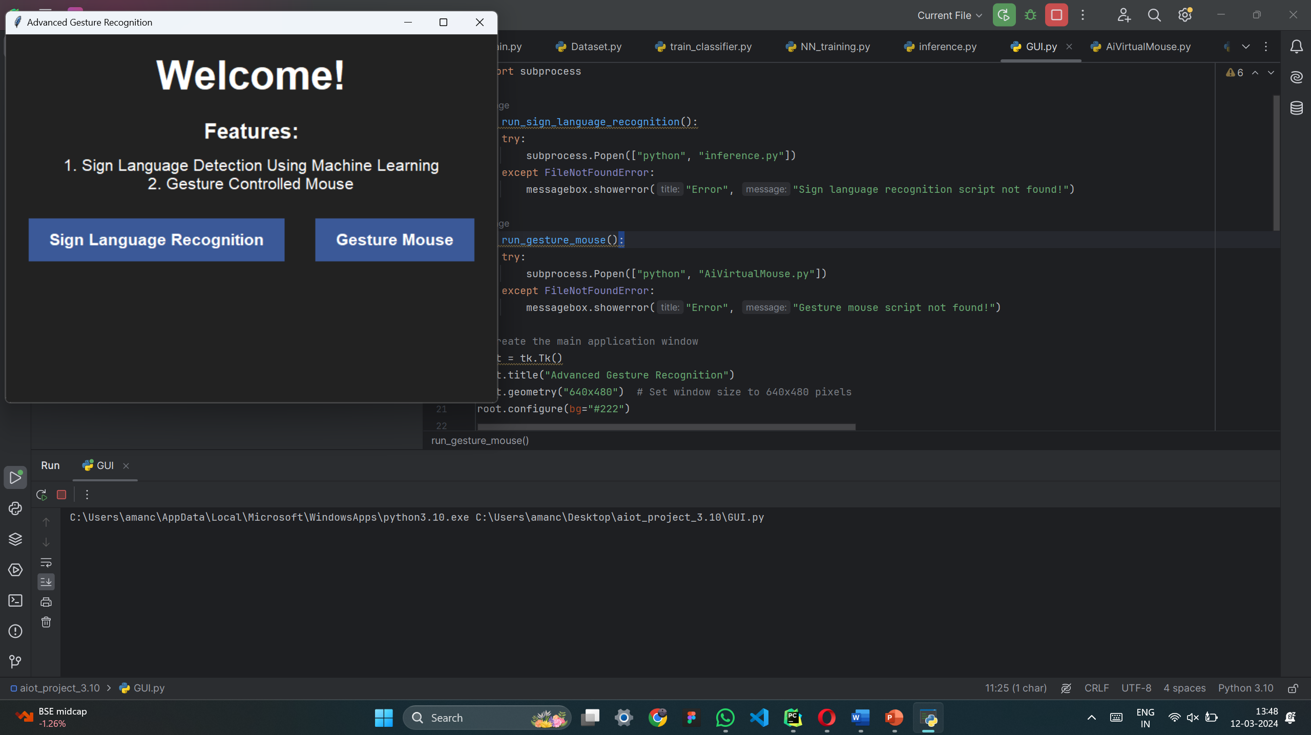
Results

Slide 19
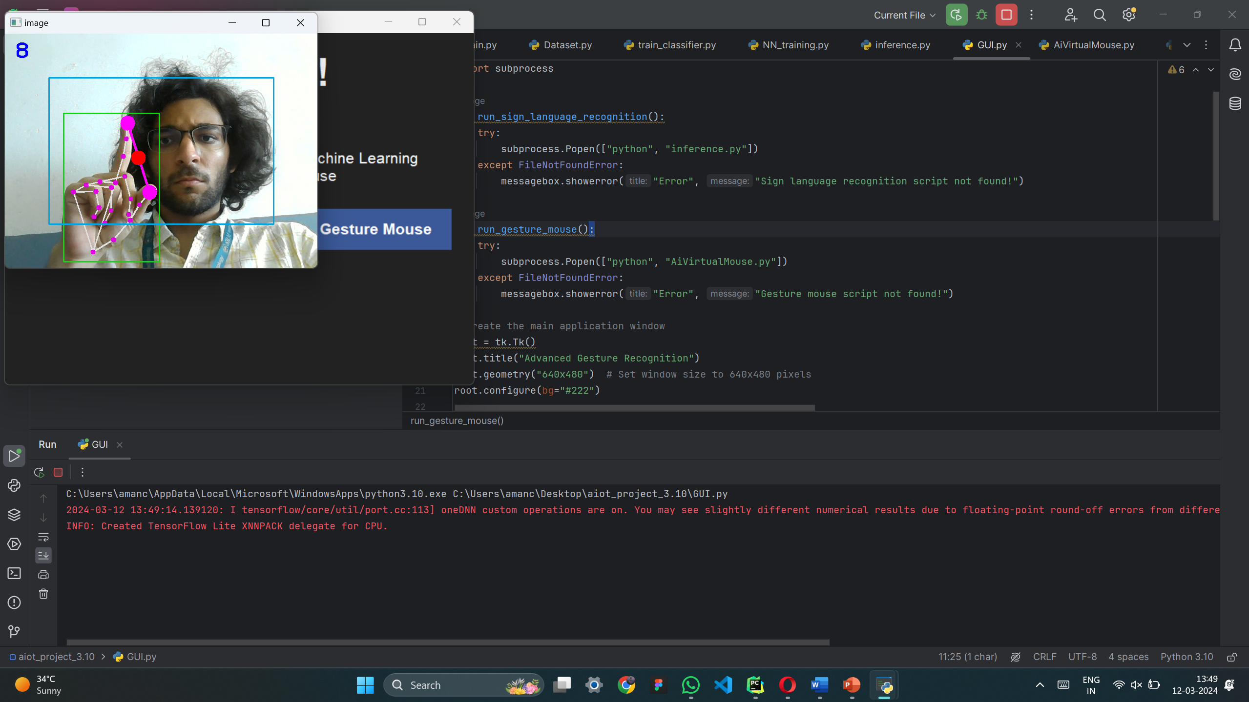
Results

Slide 20
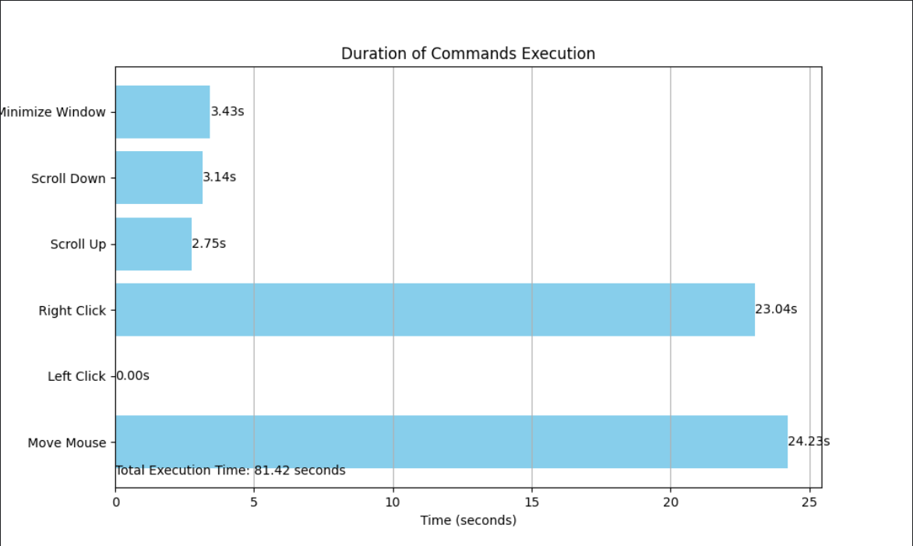
Results

Slide 21
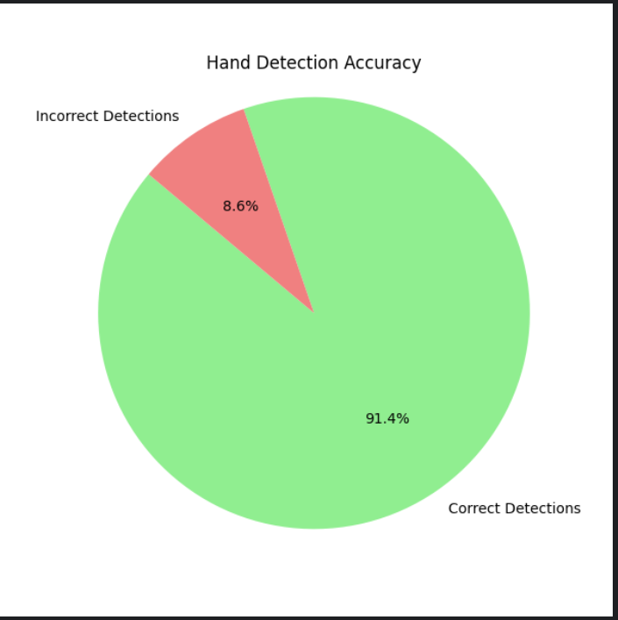
Results
Hand accuracy calc-
-ulation using
matplotlib
fps: 10.45 (avrg)

Slide 22
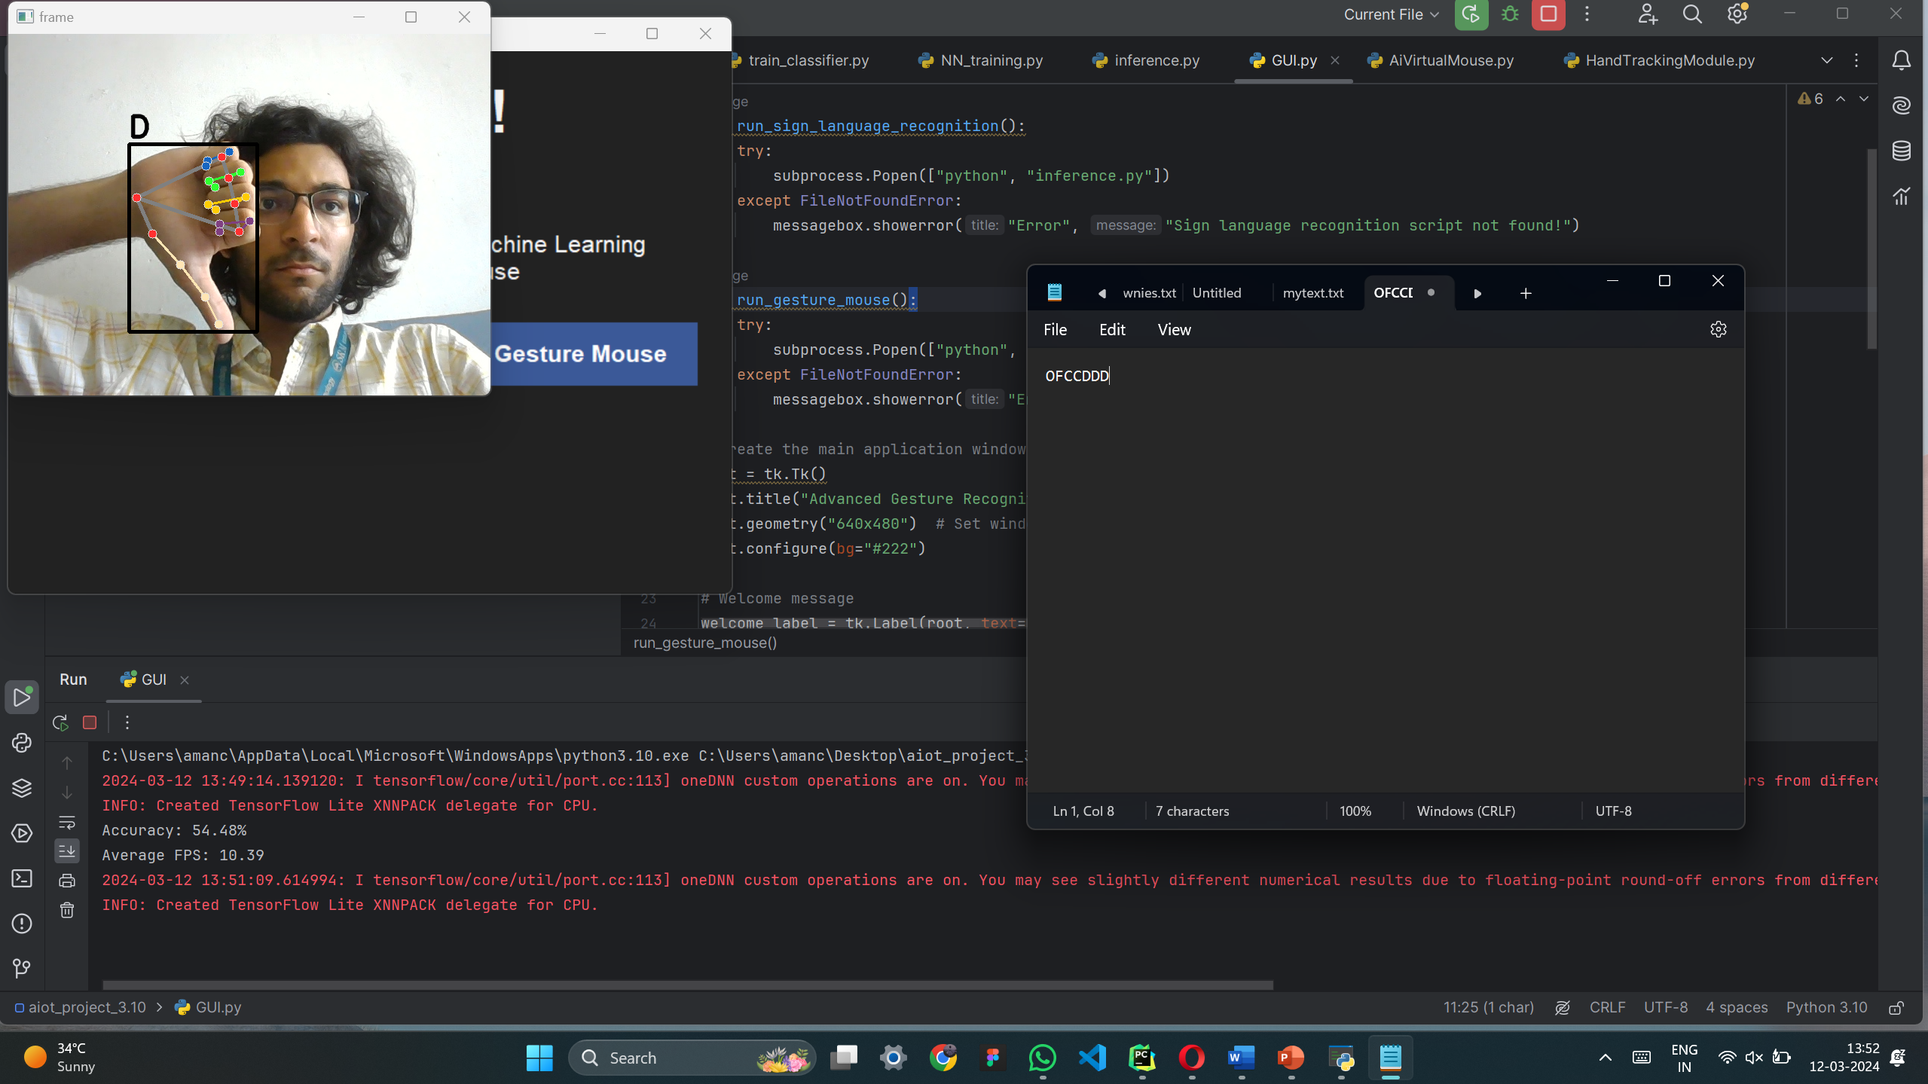
Results

Slide 23
References
[1]. Oudah, M.; Al-Naji, A.; Chahl, J. Hand Gesture Recognition Based on Computer Vision: A Review of Techniques. J. Imaging 2020, 6, 73. https://doi.org/10.3390/jimaging6080073
[2]. Tsai, Tsung-Han, Chih-Chi Huang, and Kung-Long Zhang. "Embedded virtual mouse system by using hand gesture recognition." 2015 IEEE International Conference on Consumer Electronics-Taiwan. IEEE, 2015.
[3]. Puri, Rachit. "Gesture recognition based mouse events." arXiv preprint arXiv:1401.2058 (2014).
[4]. Xu, Pei. "A real-time hand gesture recognition and human-computer interaction system." arXiv preprint arXiv:1704.07296(2017).
[5]. Balaji, R., et al. "Handwritten gesture recognition for gesture keyboard." Tenth International Workshop on Frontiers in Handwriting Recognition. Suvisoft, 2006.
[6]. Nikhil, Chinnam Datta Sai, et al. "Finger recognition and gesture based virtual keyboard." 2020 5th International Conference on Communication and Electronics Systems (ICCES). IEEE, 2020.

Slide 24
References
[7]. Bi, Xiaojun, et al. "Bimanual gesture keyboard." Proceedings of the 25th annual ACM symposium on User interface software and technology. 2012.
[8]. Lee, Tae-Ho, and Hyuk-Jae Lee. "A new virtual keyboard with finger gesture recognition for AR/VR devices." Human-Computer Interaction. Interaction Technologies: 20th International Conference, HCI International 2018, Las Vegas, NV, USA, July 15–20, 2018, Proceedings, Part III 20. Springer International Publishing, 2018.
[9]. Zhai, Shumin, and Per Ola Kristensson. "The word-gesture keyboard: reimagining keyboard interaction." Communications of the ACM 55.9 (2012): 91-101.
[10]. Kellogg, Bryce, Vamsi Talla, and Shyamnath Gollakota. "Bringing gesture recognition to all devices." 11th USENIX Symposium on Networked Systems Design and Implementation (NSDI 14). 2014.

Slide 25
Paper Status/ Report Status
The abstract, introduction and related work is completed with the references and literature survey. (approx. 40 – 50%)
For the report till methodology everything is made and approximately 50% is completed
Around 1 more week to complete the entire paper and report then will apply for publishing

Slide 26
THANK YOU

